Slide 1
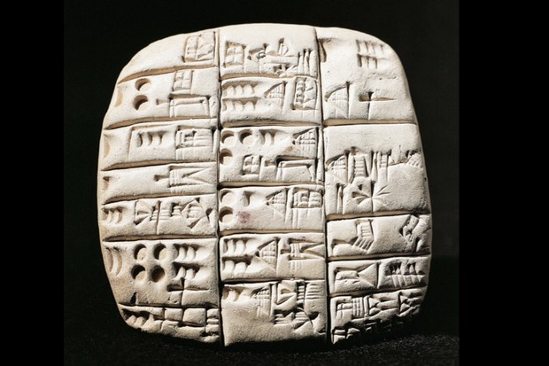
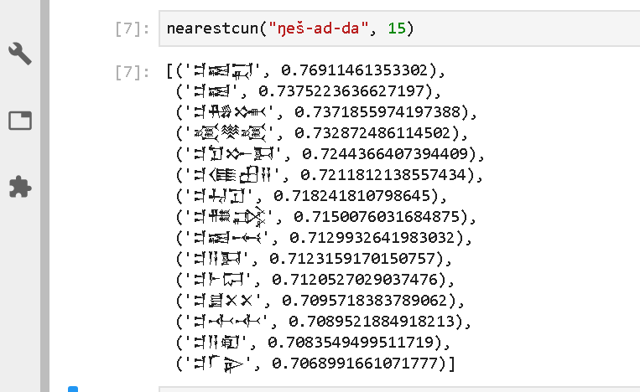
Data Science for Hard Core Humanists
Opportunities and Challenges in Computational Assyriology
Niek Veldhuis, UC Berkeley
BIDS, March 4 2020

Slide 3
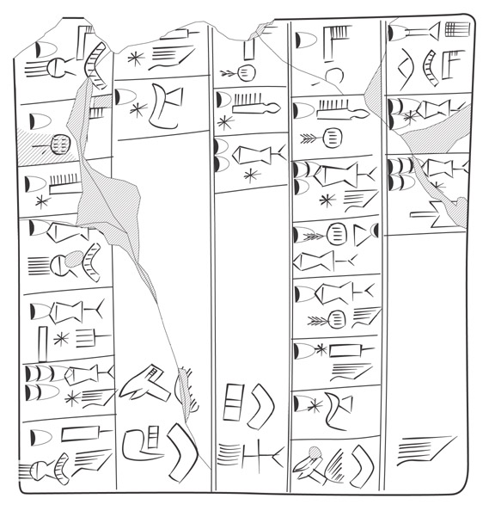
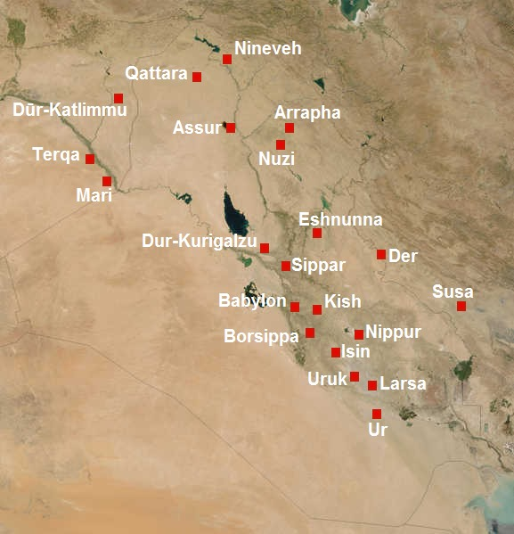
Archaic Metals Account
Notes:
https://cdli.ucla.edu/dl/lineart/P001993_l.jpg

Slide 4
Cuneiform: A Schematic History
3,200 Administrative, School Texts
2,700 Royal Inscriptions
2,500 Literary (Sumerian)
2,400 Letters
1800 Divination, Literary (Akkadian), Medical, Mathematical
500 Astronomical Tables
0 The End
Akkadian: Semitic
Sumerian: Isolate

Slide 5
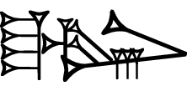

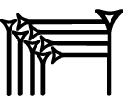

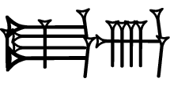

Transliteration, Lemmatization
Transliteration: lugal-e e₂ mu-un-du₃
Lemmatization: lugal[king]N e[house]N du[build]V/t
Translation: The king built the temple

Slide 6
Main Digital Cuneiform Projects
 | ETCSL | CDLI | ORACC | Archibab | SEAL | EbDA | BDTNS
Specialty | Literary | Metadata |  | Admin | Literary | Admin | Admin
Language | Sumerian |  | Sumerian Akkadian | Akkadian | Akkadian | Eblaite | Sumerian
Lemm | Yes | No | Yes | Yes | No | Yes | No
Texts | 400 | 350,000 | 150,000 | 20,000 | 900 | 3,000 | 65,000
Period | 1800 |  |  | 1800 | 1500 | 2300 | 2050
Output | XML | TXT | JSON | PDF | PDF | HTML | TXT
Active | 1996-2006 | 1998 - | 2006 - | 2009 - | 2008 - | 2016 - | 2002 -
Open | Yes | Yes | Yes | No | No | ? | Yes

Slide 7

Berkeley
2013- DLAB
2013- BIDS
2015- Data8
2016-2018 Berkeley Summer Institute for Digital Humanities
2018 Division of Data Science

Slide 8
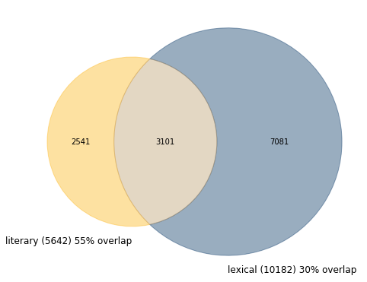
Potential: Scaling Up
Old Babylonian Scribal School:
Teach Sumerian through
Lexical lists
Literary Heritage
Do lexical texts introduce the vocabulary of the literary heritage?

Slide 9
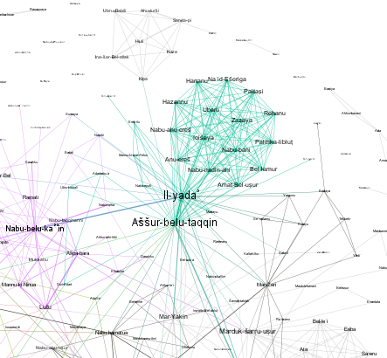
Potential: Social Networks
Letters to Sargon (8th Century king of Assyria)
Visualization in Gephi with modularity score
Notes:
Letters to Sargon with Modularity

Slide 10
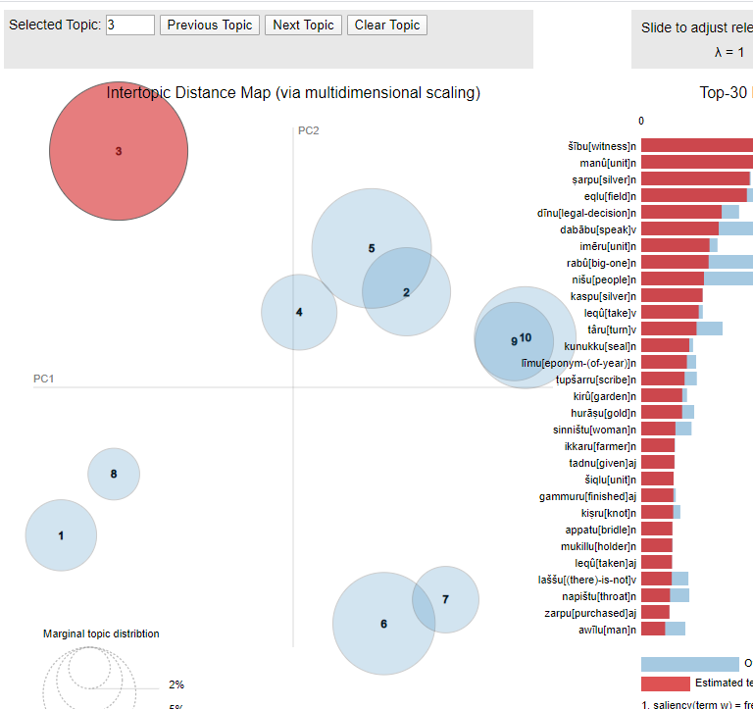
Potential: Topic Model
Probability distribution of words over topics visualization (ldaviz)
Probability distribution of topics over documents visualization (in Bokeh)
Neo-Assyrian letters and administrative texts (9th-7th century).

Slide 11

Potential: Word Embeddings
ŋeš-ad-da
Sumerian terminology for ship building

Slide 12
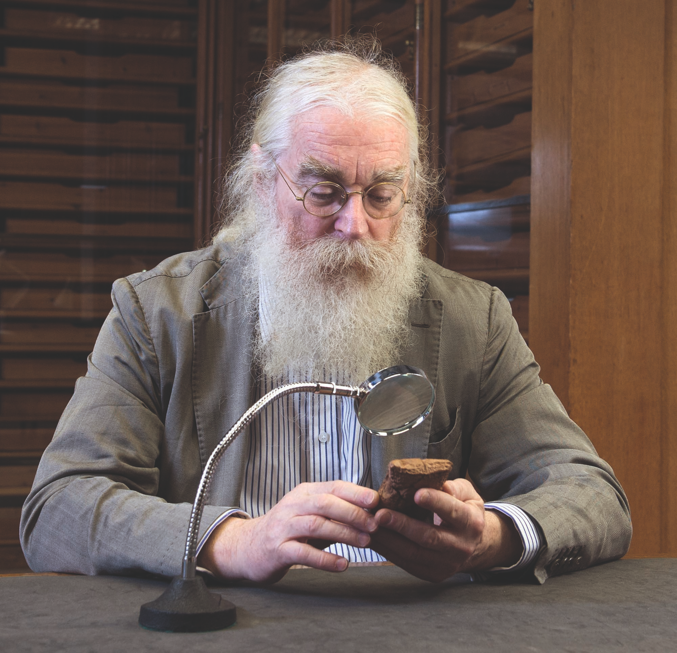
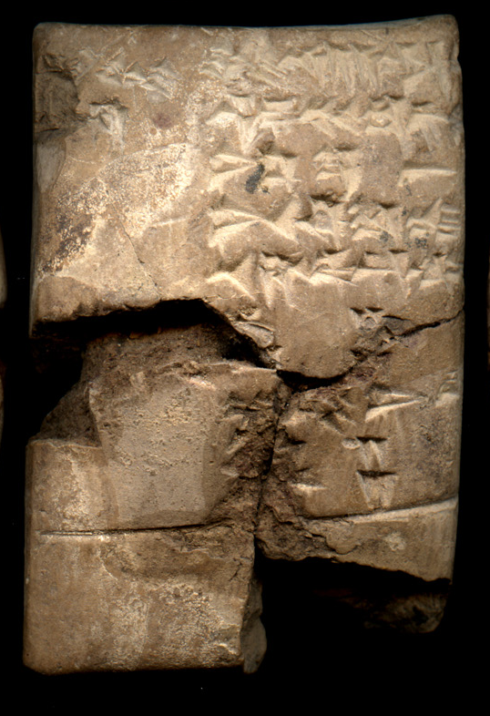
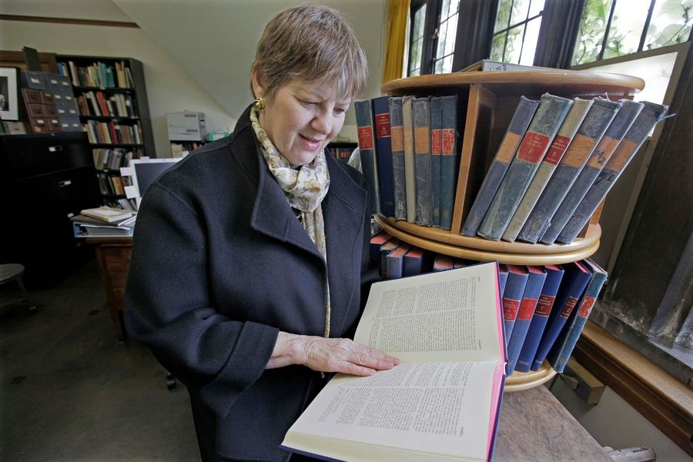
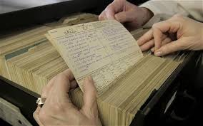
Are they Interested?

Slide 13
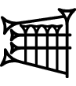

Sign Searching
Multivalent signs:
su
su, sug₆
kuš
Flesh
To replace
Hide, leather
hi
du₁₀
dub₃, du₁₀
dug₃, du₁₀
šar₂
To mix
Syllable /du/
Knee
Good
3,600

Slide 14
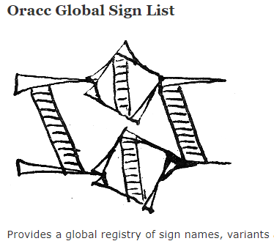

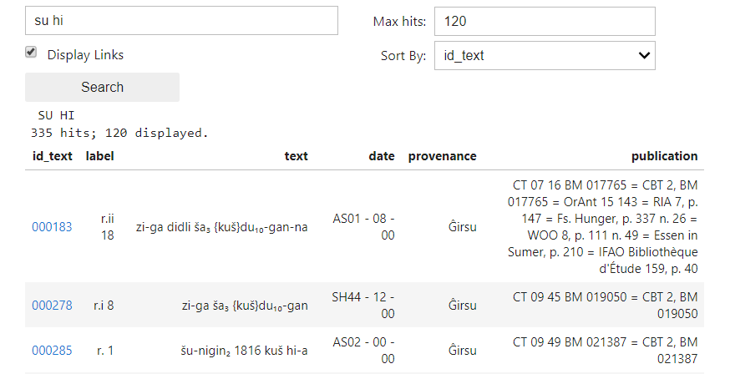
Mash-up
BDTNS: Database of Neo-Sumerian Texts

Slide 15
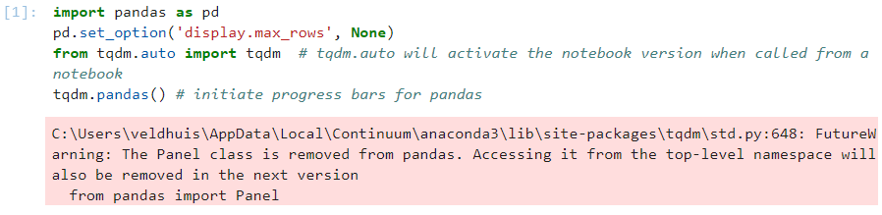
Really?
Pandas vs. tqdm
Installing ipywidgets for Jupyter Lab

Slide 16
Changing Attitudes
 | ETCSL | CDLI | ORACC | Archibab | SEAL | EbDA | BDTNS
Specialty | Literary | Metadata |  | Admin | Literary | Admin | Admin
Language | Sumerian |  | Sumerian Akkadian | Akkadian | Akkadian | Eblaite | Sumerian
Lemm | Yes | No | Yes | Yes | No | Yes | No
Texts | 400 | 350,000 | 150,000 | 20,000 | 900 | 3,000 | 65,000
Period | 1800 |  |  | 1800 | 1500 | 2300 | 2050
Output | XML | TXT | JSON | PDF | PDF | HTML | TXT
Active | 1996-2006 | 1998 - | 2006 - | 2009 - | 2008 - | 2016 - | 2002 -
Open | Yes | Yes | Yes | No | No | ? | Yes

